Slide 1
"Your next favorite vacation destination with Airbnb"
Airbnb New User Bookings
By
Sharfuddin Alam

Slide 2
Motivation and Background
Airbnb as the largest internet community for booking unique accommodations around the world with one click
Kaggle Competition as a standard of Data Science Challenges
Structure and goals of the Airbnb Data Science Team
Diverse Culture and Values

Slide 3
DataSet Information
In total Six Datasets that was provided as part of
the competition
age_gender_bkts.csv
sample_submission.csv
countries.csv
sessions.csv
test_users.csv
train_users.csv

Slide 4
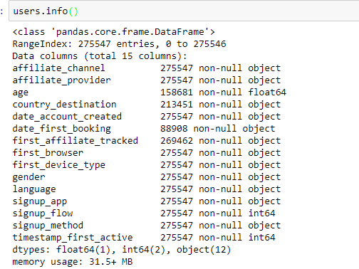
Users DataFrame info()

Slide 5
Data Wrangling Steps
Age: Users that are below 18 and above 110 years of age had been dropped
Gender: Four types of unique variables that are reduced to three; by replacing the “-unknown-” values with “NaN” values

Slide 6
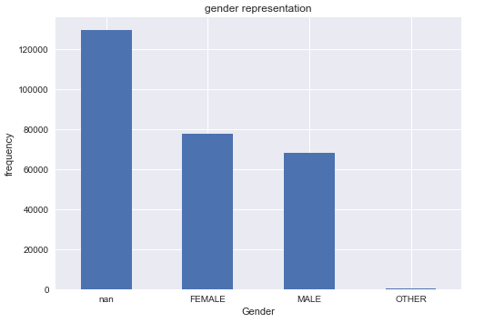
“Gender” attributes frequency plot

Slide 7
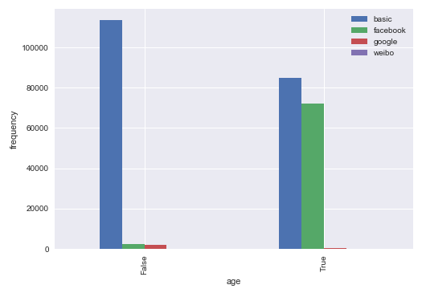
Correlation between two or more different attributes: Age and Signup Flow

Slide 8
Age and Signup Flow(contn’d)
Chart which have False shows those users which doesn't lie in the age group between 18 to 110 and the True otherwise
There is a huge popularity variation for facebook in the two users group

Slide 9
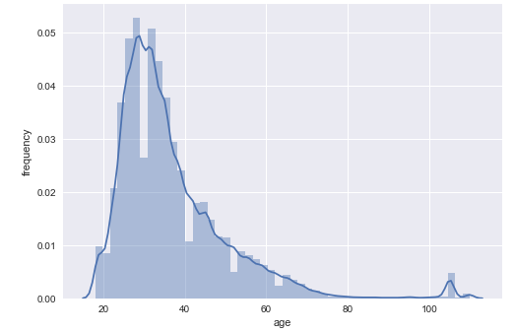
Age Group frequency Distribution

Slide 10
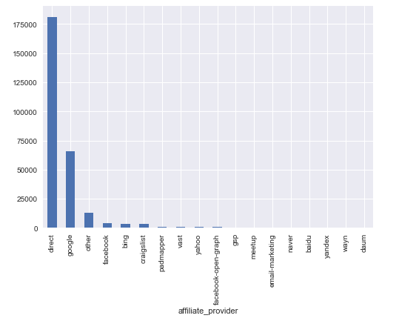
Affiliate Provider frequency plot

Slide 11
Percentage of “NaN” values of whole DataFrame
Column Name | Percentage
Age | 42.412365
Date_first_booking | 67.733998
First_affiliate_tracked | 2.208335
Gender | 46.990169

Slide 12
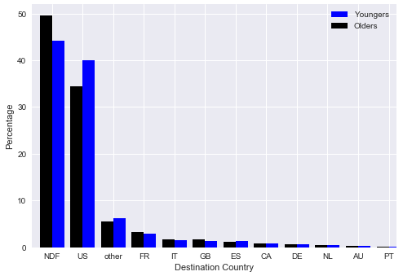
Destination Country between generations

Slide 13
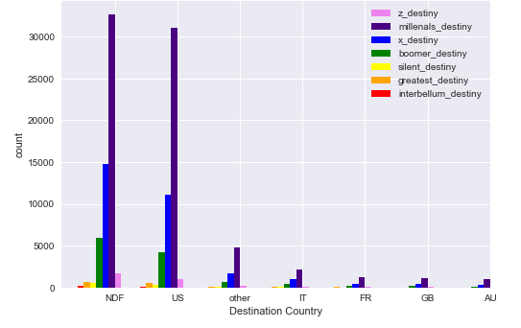
Destination Country vs Age Groups

Slide 14
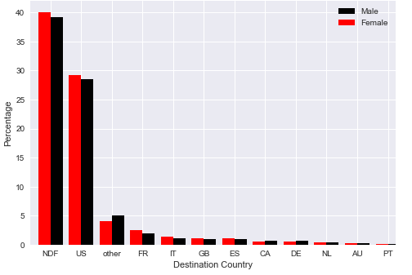
Gender Classification with Destination Country

Slide 15
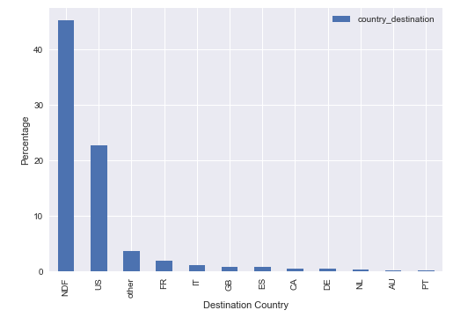
Destination Country distribution as a percentage of the overall population sample

Slide 16
Conversion of Datetime format of the three attributes

Slide 17
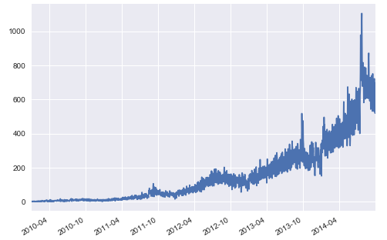
Time Series Analysis for the Date Account Created

Slide 18
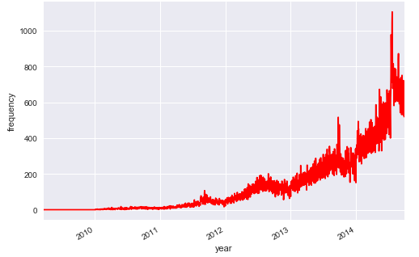
Users "first activity" yearly time series analysis

Slide 19
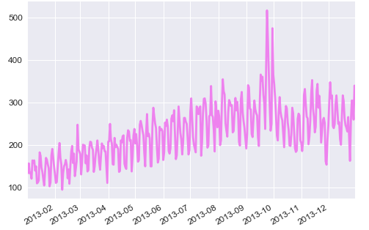
Users of 2013 that activated their account first time

Slide 20
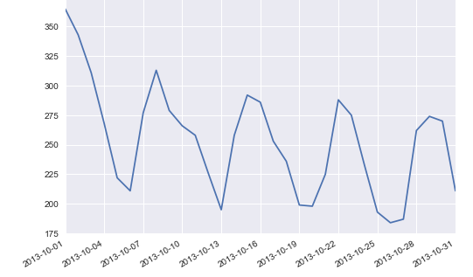
In depth analysis on the Users' activity in October 2013

Slide 21
In depth analysis on the Users' activity in October 2013 (contn’d)
At the first date of October 2013,which is a Tuesday, there were a lot of active users
The user activity dropped by significant amount in 4th of the month and kept on dropping throughout weekends
It again started to pick up on October 7th,which is a Tuesday and kept on rising at a steady pace
a trend that users are more tend to book in the middle of the weeks and active on weekdays rather than weekends
During weekends, there is a clear trend of less activity of booking which makes perfect sense

Slide 22
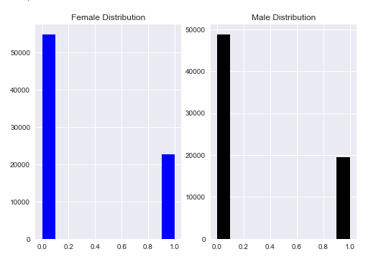
Male and Female Population Distribution categorized by destination countries

Slide 23
Hypothesis Testing
= No difference between the mean value of the Male Population and the mean value of the female population =
= There is a difference between the mean value of the Male Population and the mean value of the female population

Slide 24
Inferential Statistics
A two-sided test for the null hypothesis that 2 independent samples have identical average (expected) values
Calculated p-value is 0.001676147617343367 and the test statistic to be statistic=3.1423785772168351
The p-value is very smaller than the threshold, then we can safely reject the Null Hypothesis of equal mean value of male and female population average

Slide 25
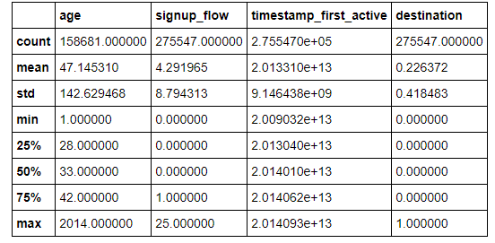
Other test statistics

Slide 26
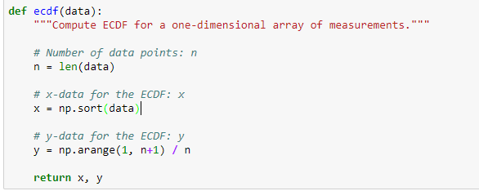
Cumulative Distribution Function(CDF)

Slide 27
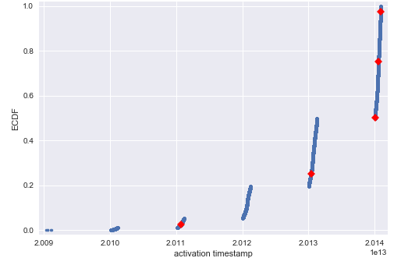
ECDF for activation timestamp and percentage distribution

Slide 28
Percentile values are as follows on those aforementioned range
[ 2.01107252e+13 2.01304032e+13
2.01401032e+13 2.01406182e+13
2.01409192e+13]
And the ecdf are:
(array([20090319043255, 20090523174809,
20090609231247, ..., 20140930235408,
20140930235430, 20140930235901],
dtype=int64), array([ 3.62914494e-06,
7.25828987e-06, 1.08874348e-05, ..., 9.99992742e-01, 9.99996371e-01,
1.00000000e+00]))

Slide 29
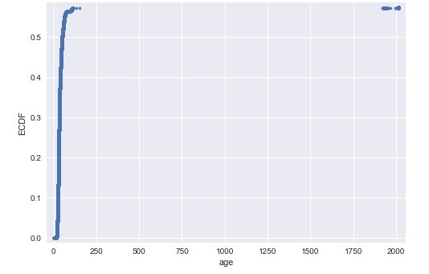
ECDF for age

Slide 30
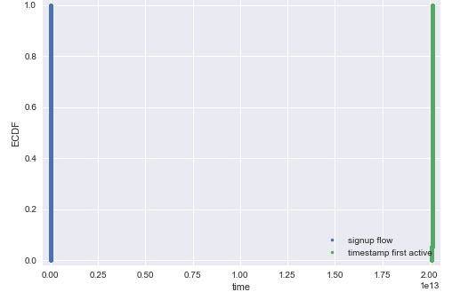
ECDF of signup flow and timestamp first active

Slide 31
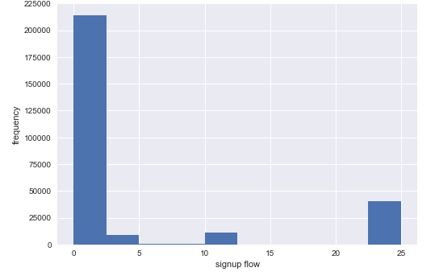
Histogram plot for the signup flow against frequencies

Slide 32
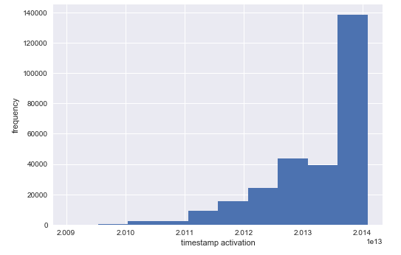
Timestamp Activation Histogram Distribution

Slide 33
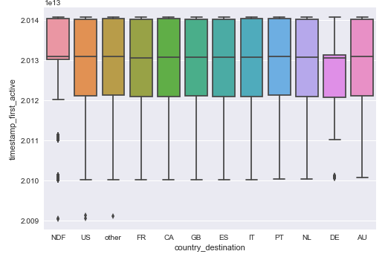
"timestamp_first_active" vs "country_destination"

Slide 34
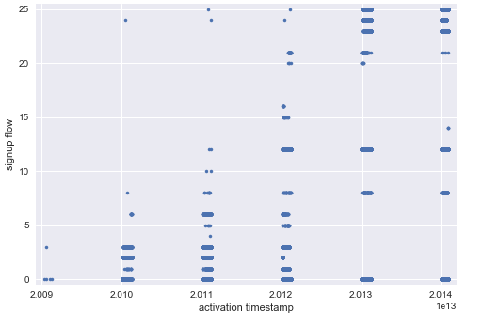
"Signup flow" vs the "activation timestamp"

Slide 35
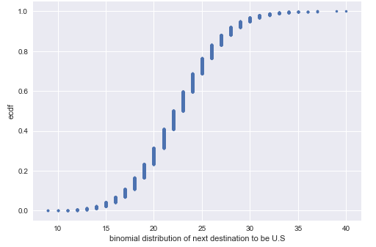
Binomial Distribution of the next destination to be in US

Slide 36
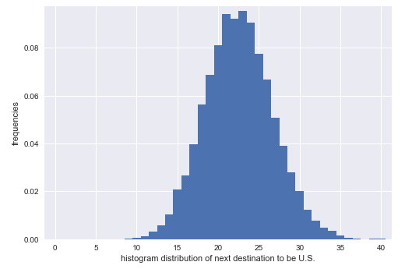
Histogram distribution of next destination to be US

Slide 37
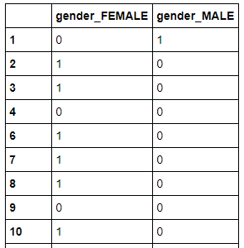
Feature Selection, Dummy Variables and One Hot Encoding
gender_dummies=pd.get_dummies(df.gender,prefix='gender').iloc[:,0:2]
gender_dummies

Slide 38
Feature Selection, Dummy Variables and One Hot Encoding(contn’d)
Index(['age', 'country_destination', 'signup_flow', 'timestamp_first_active', 'gender_FEMALE', 'gender_MALE', 'signup_app_Moweb', 'signup_app_Web', 'signup_app_iOS', 'affiliate_channel_content', ... 'language_ko', 'language_nl', 'language_no', 'language_pl', 'language_pt', 'language_ru', 'language_sv', 'language_th', 'language_tr', 'language_zh'], dtype='object', length=116)

Slide 39
Train Test Split
X_train,X_test,y_train,y_test=train_test_split(X,y,test_size=0.30,random_state=42)
used to split the X and y into train and test sets
The test_size = 0.30 implies that the size of the test set is30% of the original data
The random_state=42 is where the splitting happens on the original Data.

Slide 40
KNN or K-Nearest Classifier
3 important aspects:
Ease to interpret output
2. Calculation time
3. Predictive Power
KNN algorithm fairs across all parameters of considerations. It is commonly used for its easy of interpretation and low calculation time. The principle of how KNN works the theoretical aspects of it are not discussed in this report.

Slide 41
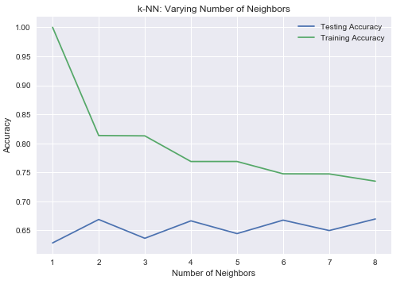
K-NN varying Number of Neighbors

Slide 42
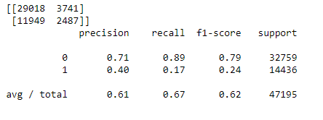
Confusion Matrix and Classification Report for k=6

Slide 43
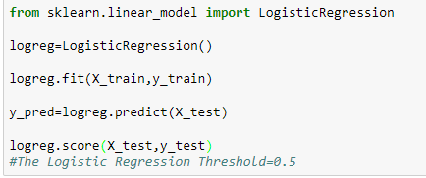
Logistic Regression

Slide 44
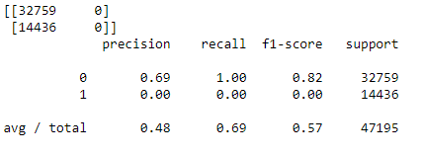
Confusion Matrix and Classification Report for Logistic Regression

Slide 45
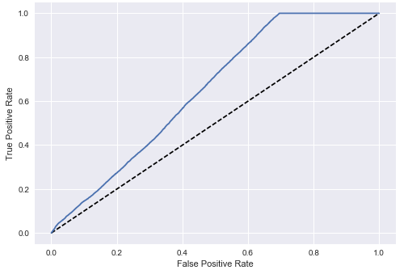
ROC Curve for the True Positive vs False Positive Rate

Slide 46
Conclusion and Future Work
Both the model shows a good performance with 0.67% and 0.69% accuracy rate
Logistic Regression is a better classifier with high accuracy rate
Accuracy can be further improved by reducing the number of features and dimensional reduction
SVM and Random Forrest and other crossbreed model in order to get a better performance for the classification of "Airbnb New Users' next Vacation Destination"

